Slide 1
Chongqing University of Technology
ATAI
Advanced Technique of Artificial Intelligence
Chongqing University of Technology
Retrospective Reader for Machine Reading Comprehension
AAAI_2021
Code : https://github.com/cooelf/AwesomeMRC
Dataset : https://rajpurkar.github.io/SQuAD-explorer/
Reported by Xinsheng Wang

Slide 2
Chongqing University of Technology
ATAI
Advanced Technique of Artificial Intelligence
Chongqing University of Technology
1.Introduction
2.Method
3.Experiments
4.Conclusion

Slide 3
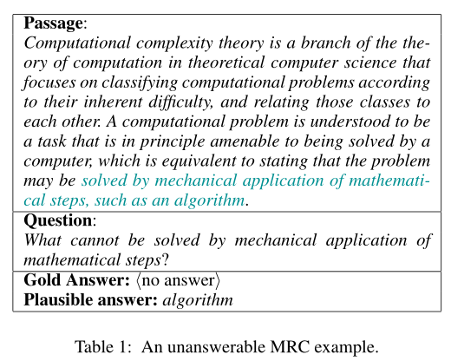
Introduction

Slide 4
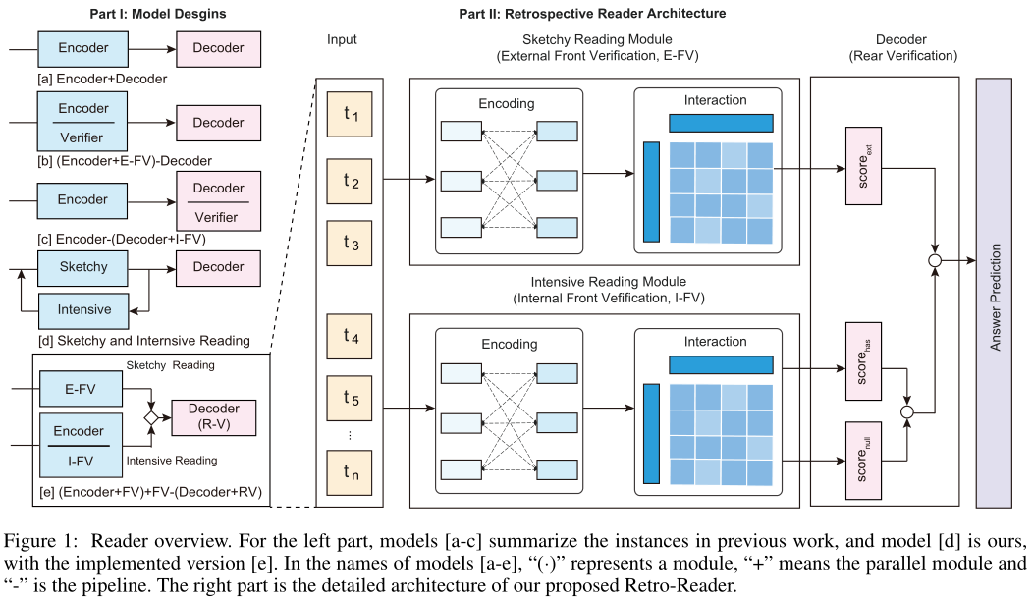
Method
Sketchy Reading Module
Input:
Embedding:
Encoder:
Notes:
将问题Q和文本P，拼接起来作为输入，[CLS]P[SEP]Q[SEP],即T。
h1即为[CLS]，包含序列的整个信息状态。
y进行sofamax，由于是二分类（能回答和不能回答），因此y由两个概率值组成。
Encoder用的由bert-large、albert-xxlarge、elctra-large
FFN(h1),先归一化在经过一个全连接
损失函数为交叉熵Loss

Slide 5
Method
Input:
Intensive Reading Module
Embedding:
Encoder:
如果最终分数v高于阈值δ，该模型预测出答案范围，否则为空字符串。
Notes:
e是一个全为一的向量，用来将偏置向量重复到矩阵中。
如果最终分数v高于阈值δ，该模型预测出答案范围，否则为空字符串。

Slide 6
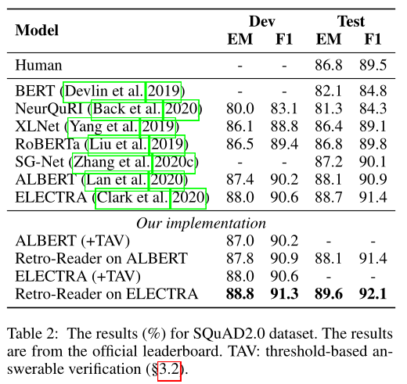
Experiments

Slide 7
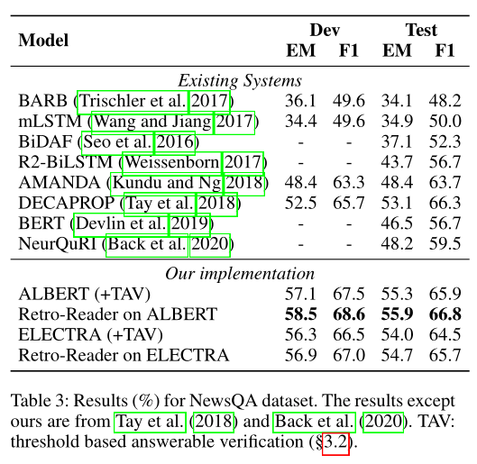
Experiments

Slide 8
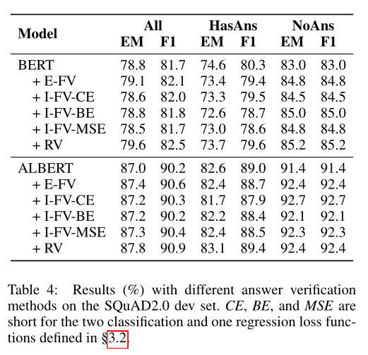
Experiments

Slide 9
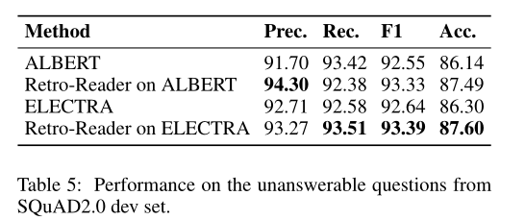
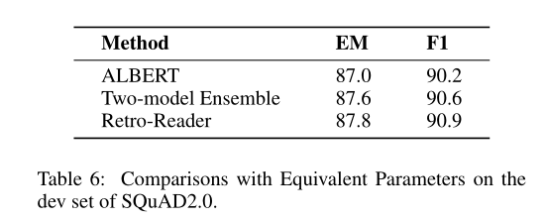
Experiments

Slide 10
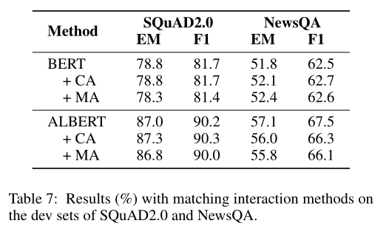
Experiments

Slide 11
Conclusion
As machine reading comprehension tasks with unanswerable questions stress the importance of answer verification in MRC modeling, this paper devotes itself to better verifier-oriented MRC task-specific design and implementation for the first time.
Inspired by human reading comprehension experience, we proposed a retrospective reader that integrates both sketchy and intensive reading.

Slide 12
Thank you!

